Slide 1
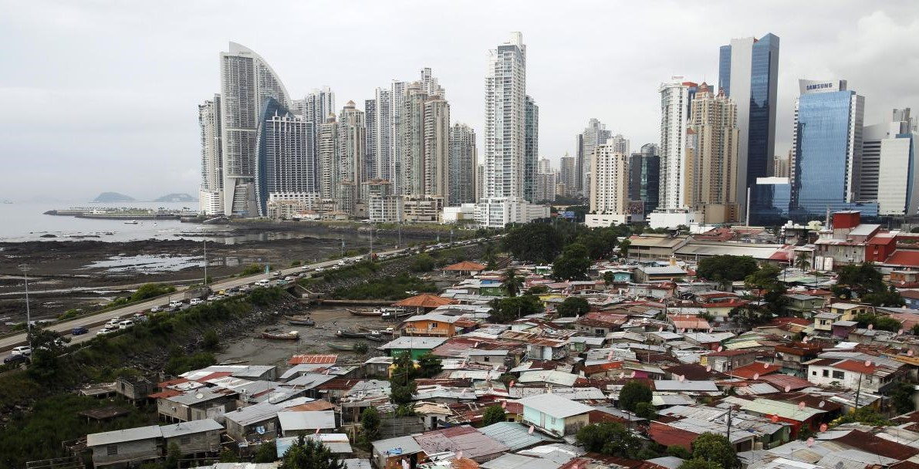

Health Inequality and Public Policy
(4)
Health inequality attributions
Monday, 6. October 2025
Ass.-Prof. Dr. David Weisstanner
Faculty of Health Sciences and Medicine
University of Lucerne

Slide 2
Organizational: Presentations written project
24. November | 1. December
Cedric Aschwanden & Micha Derendinger | Lara Stiefel
Larissa Kappes & Lenya Helfenstein | Yelina van Gennep
Rahel Schuler & Anina Landert | Joelle Küng & Valentina Vuckovic
Annina Neff & Luc Party | Ekaterina Protsenko
Luana Veiga | Raja Pfisterer
Angela Häberli | Ronja Stahl
Lisa Stocker & Alina Holdener | Leon Maximilian Strauß
Kevin Cody | Beatrice Bättig & Sandra Steinmann
Ladina Zimmermann | Joelle Erismann & Sarah Suter
Linda Keller & Natacha Wälti | Liza Widmer
Leoni Ritter | Solange Herrera
Elena Waibel

Slide 3
Recap last week
Behavioural explanations
Material explanations
Psychosocial explanations
Unequal health risks (smoking, diet, exercise, alcohol)
Unequal living/working conditions and resources
Unequal stress, job strain, social support, control

Slide 4
Link to this week’s topic
Behavioural explanations
Material explanations
Psychosocial explanations
Unequal health risks (smoking, diet, exercise, alcohol)
Unequal living/working conditions and resources
Unequal stress, job strain, social support, control
These are causal models, rooted in epidemiology/social medicine, about what drives health outcomes. (objectively)
This week: When ordinary citizens are confronted with health inequality, how do they explain it? (subjectively)

Slide 5
Baute’s typology of health inequality attribution
Behavioural attribution
      Health-risk behaviours (smoking, diet, activity, alcohol), lifestyle & choices
Biological attribution
      Genetics, inborn traits, health selection
Environmental attribution
      Living & working conditions, pollution, housing, hazards
Healthcare attribution
      Unequal access, treatment quality, provider bias, system barriers
Overlap with last week’s theories of health inequality?

Slide 6
Operationalization of the typology
“On average, Germans with a low income live 6 years shorter than Germans with a high income. What do you think is the main reason for this shorter lifespan?”
1 = “Because their own behaviour damages their health.”
2 = “Because of inborn characteristics.”
3 = “Because of the environmental conditions they are exposed to at work or where they live.”
4 = “Because of unequal treatment in the healthcare system.”
(randomized order)

Slide 7
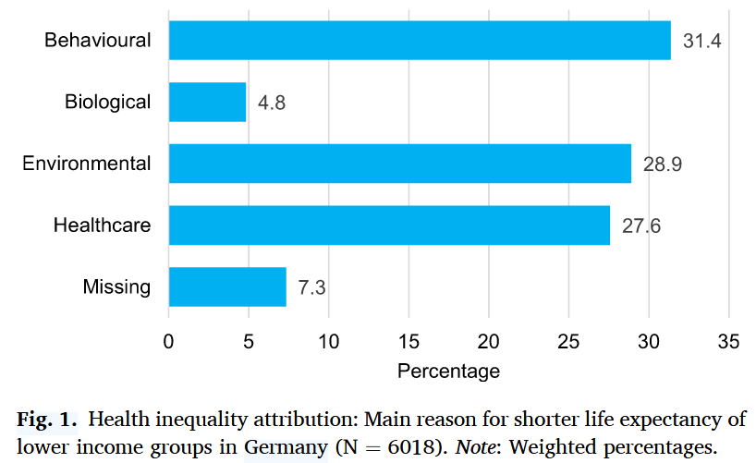
Results: Popular explanations of health inequalities
Higher income
Right-wing ideology
+
+
Left-wing ideology
+
Lower income
+
Notes:
Explaining factors: 3 I’s (interests, ideology, institutions)
Overall, the findings support the fundamental attribution bias (Jones and Harris, 1967; Ross, 1977), where individuals tend to overemphasize individual factors while underestimating contextual factors in explaining others’ behaviour.

Slide 8
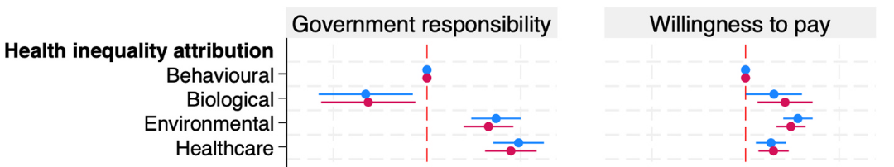

Consequences (1): healthcare solidarity
Assumption:
Health inequality attribution → degree of risk controllability → health policy attitudes

Slide 9
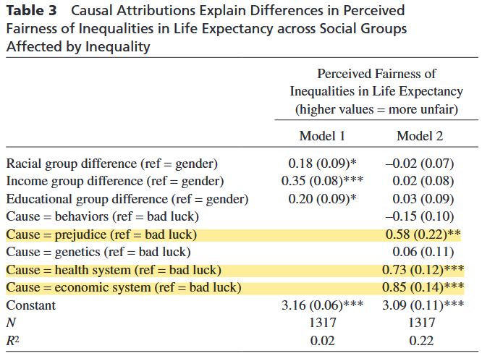
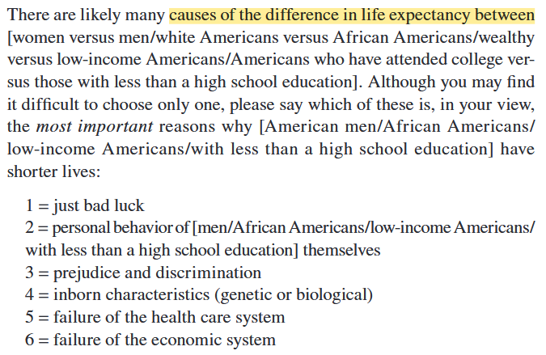
Consequences (2): (un)Fairness of health inequality
Representative US survey, 2007 (N=1317)
Notes:
In turn: Perceived unfairness of health inequalities → Support for Government Provision of Health Insurance

Slide 10
Generalizability – ISSP Items on causes of health
Schnittker (2015) and Bridger (2023) use the ISSP 2011 to analyse health causation beliefs
“Severe health problems may have many causes. How much do you agree or disagree with the following statements? People suffer from severe health problems,
because they behaved in ways that damaged their health,
because of the environment they are exposed to at work or where they live,
because of their genes,
because they are poor.”
(5-point Likert scale from “strongly agree” to “strongly disagree”)
Notes:
What do people understand by «severe» health problems?

Slide 11
Cross-country variation
Aim: Analyse how health causation beliefs vary across countries
Task (10-15 min, individually or in small groups):
  Study the distribution of health causation beliefs across countries on the next three slides
      ISSP 2011
      ISSP 2021
      Change 2011 to 2021
      (Stata code for the graphs available on Moodle)
  Analyse and evaluate the patterns:
  Are health causation beliefs similar across countries or do they differ?
  Which countries put more emphasis on behaviour/genes, with potentially lower support for policies to address health inequalities?
  Which countries put more emphasis on environment/poverty, with potentially higher support for policies to address health inequalities?

Slide 15
Summing up
From scientific theories explaining what drives health inequalities (behavioural, materialist, psychosocial) to subjective attributions of health inequalities and causes of health (behavioural, biological, environmental, healthcare)
Attributions/beliefs of health causes are not equally distributed across time, across countries, or across individuals (e.g. role of income and political ideology)
Beliefs matter: attributions shape support for healthcare solidarity and health inequality reduction:
behavioural blame weakens it, structural explanations strengthen it

Slide 16
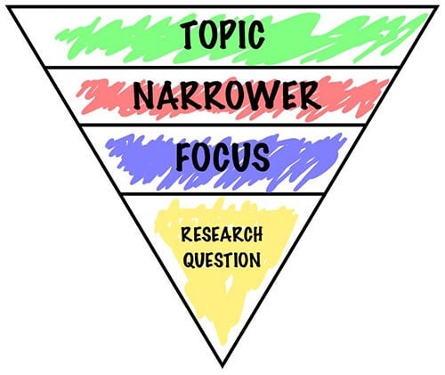
From Topic to research question
Example:
Broad topic: Health inequality
Narrower focus: The impact of socioeconomic status on self-rated health
More specific focus: The role of relative deprivation in the link between income and self-rated health
Research question: How does household income influence self-rated health among adults through feelings of relative deprivation?
Or:
Research question: To what extent do feelings of relative deprivation explain the relationship between household income and self-rated health in adults?

Slide 17
What is a good research question?
CARS…
Clear: Your audience should be able to understand the question easily ✅
Answerable: It should be possible and feasible to give a methodologically rigorous answer to the question using the empirical data at hand ✅
Relevant: The question has (1) practical/societal relevance and (2) academic/scientific relevance ✅
Specific: The question should be narrow/focused enough to be answered within the scope of the assignment and the available empirical data ✅

Slide 18
Research questions – what to avoid ⚠️
The question is too broad, too general, not specific enough 🚫
The question is descriptive, not analytical (you want to analyse/explain a problem, not just describe it) 🚫
The question is not feasible (you don’t have the necessary data and methods to answer it) 🚫
The question lacks academic/scientific relevance 🚫
The question lacks practical/societal relevance 🚫
The question is too easy to answer (yes/no, https://letmegooglethat.com/) 🚫
You don’t enjoy working on the question 🚫

Slide 19
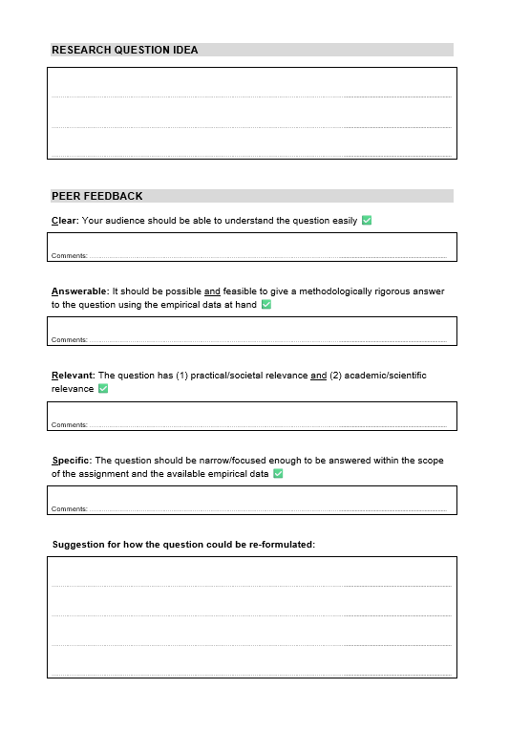
Exercise: Peer feedback on Research questions
Task 1 (10 min):
(Re-)formulate the topic/research question that you prepared into a CARS research question (clear, answerable, relevant, specific)
→ write it down on the paper provided.
Task 2 (10 min):
Form groups of 2 or 3 students. Exchange the papers with the research questions, and provide written feedback on your colleagues’ question: Is it CARS? Suggestions how to reformulate it?
Task 3 (10 min):
Discuss and explain the feedback in the group: What did you like about the research question idea? What did you suggest to change? Discuss clarifying questions and lessons learned.

Slide 20
Plenary Discussion
What have you learnt on how to improve your topic / research question ideas for the health inequality research project?
What challenges are there to come up with CARS research question for this course? And what could be good solutions to overcome these challenges?

Slide 21
Outlook next week
5 13.10.2025 Socio-economic health inequalities
Weeks 5-8: zooming in on specific health inequality areas
Week 5: SES as a multidimensional concept; main indicators; key mechanisms
Reading: Link, B. G., García, S. J., Firat, R., La Scalla, S., & Phelan, J. C. (2024).
Socioeconomic-Status-Based Disrespect, Discrimination, Exclusion, and Shaming: A Potential
Source of Health Inequalities? Journal of Health and Social Behavior, 65(4), 558–576.
Applied focus: Disparities by education, occupation, income, subjective SES

Slide 22
References
Baute, S. (2025). Health inequality attributions and support for healthcare policy. Social Science & Medicine, 117946. https://doi.org/10.1016/j.socscimed.2025.117946
Baute, S., & Bellani, L. (2024). Healthcare deservingness: How risk factors and income shape responsibility attribution for health outcomes and healthcare costs. European Sociological Review, jcae049. https://doi.org/10.1093/esr/jcae049
Bridger, E. K. (2023). Subjective socioeconomic status and agreement that health is determined by distal and proximal factors. International Journal of Psychology, 58(6), 536–544. https://doi.org/10.1002/ijop.12928
Bridger, E. K., Tufte-Hewett, A., & Comerford, D. A. (2023). Dispositional and situational attributions for why the rich live longer than the poor. Journal of Applied Social Psychology, 53(6), 469–481. https://doi.org/10.1111/jasp.12955
Davies, B., & Savulescu, J. (2019). Solidarity and Responsibility in Health Care. Public Health Ethics, 12(2), 133–144. https://doi.org/10.1093/phe/phz008
Gollust, S. E., & Lynch, J. (2011). Who Deserves Health Care? The Effects of Causal Attributions and Group Cues on Public Attitudes About Responsibility for Health Care Costs. Journal of Health Politics, Policy and Law, 36(6), 1061–1095. https://doi.org/10.1215/03616878-1460578
Lundell, H., Niederdeppe, J., & Clarke, C. (2013). Public Views About Health Causation, Attributions of Responsibility, and Inequality. Journal of Health Communication, 18(9), 1116–1130. https://doi.org/10.1080/10810730.2013.768724
Lynch, J., & Gollust, S. E. (2010). Playing Fair: Fairness Beliefs and Health Policy Preferences in the United States. Journal of Health Politics, Policy and Law, 35(6), 849–887. https://doi.org/10.1215/03616878-2010-032
McCauley, A., & Ruggeri, A. (2020). From Questions and Puzzles to Research Project. In L. Curini & R. Franzese (Eds.), The SAGE Handbook of Research Methods in Political Science and International Relations (pp. 26–43). SAGE Publications Ltd. https://doi.org/10.4135/9781526486387
Robert, S. A., Booske, B. C., Rigby, E., & Rohan, A. M. (2008). Public views on determinants of health, interventions to improve health, and priorities for government. WMJ: Official Publication of the State Medical Society of Wisconsin, 107(3), 124–130.
Schnittker, J. (2015). The Politics of Health Beliefs: Cross-National Evidence. In Education, Social Factors, and Health Beliefs in Health and Health Care Services (Vol. 33, p. 0). Emerald Group Publishing Limited. https://doi.org/10.1108/S0275-495920150000033002
Wagner, A. J. M., Reifegerste, D., & Scherr, S. (2025). The Same, but Different: Understanding Responsibility Attributions for Depression with a Cross-national Survey in the United States and Germany. Health Policy, 105445. https://doi.org/10.1016/j.healthpol.2025.105445

